Slide 1
PowerPoint Presentation Structure

Slide 2
Churn Prediction Data Analysis Actionable recommendations for the head to launch a business audience
Based on telecom dataset
Presenter: Antonine Pelicier
Email: antoninepelicier10@gmail.com
Date: 08/17/2025

Slide 3
Introduction & The Business Problem(Overview)

Slide 4
My Data Source
To uncover these insights, I've analyzed data from one key industry source:
Bigml: It is a dataset commonly used for a customer churn prediction analysis, from a telecommunications company and contains various details about customer accounts. The key purpose of this dataset is to predict whether a customer will stop using the service (churn) based on their behavior and account information.

Slide 5
Business Problem
The core business problem is to predict which customers are likely to churn, enabling the telecommunications company to proactively target them with retention campaigns. This is a critical task, as retaining existing customers is significantly more cost-effective than acquiring new ones.

Slide 6
Stakeholder
The primary stakeholder is the Customer Retention Manager. They are directly responsible for reducing churn and would use the predictive model's output to identify at-risk customers. This allows them to allocate resources effectively and implement personalized strategies, such as offering discounts or service upgrades, to prevent customers from leaving.

Slide 7
Predicting and Preventing Customer Churn: A Data-Driven Approach
This presentation outlines how I used data to build a model that predicts which customers are at risk of leaving our service. My goal is to give our teams the information they need to act proactively and reduce customer churn.

Slide 8
Business & Data Understanding

Slide 9
The Problem: Why Churn Matters
The Business Problem: Losing customers is expensive. It costs more to acquire a new customer than to keep an existing one. By identifying at-risk customers early, we can intervene with targeted strategies and improve our profitability.
Our Data: We analyzed customer data, including account history, service usage, and customer support interactions. This information was the foundation for building our predictive model.

Slide 10
Our Approach Building a Predictive Model

Slide 11
A New Tool for the Retention Manager
What is a Predictive Model? Think of our model as a smart system that analyzes customer behavior patterns to sort them into two groups: those who will likely stay and those who will likely leave.
I built and tested a few different models and found that a Tuned Decision Tree was the best at identifying at-risk customers.

Slide 12
Model Performance: How Our Model Performed

Slide 13
How Accurate Is Our Prediction?
This chart, called a Confusion Matrix, shows us how well our model's predictions matched reality.
True Negatives (Top-Left): We correctly predicted that 550 customers would not leave.
False Positives (Top-Right): We incorrectly flagged 20 customers as at-risk, but they stayed.
False Negatives (Bottom-Left): We missed 72 customers who ended up leaving. This is a critical group to focus on improving.
True Positives (Bottom-Right): We correctly identified 25 customers who were going to leave.
Key takeaway: The model is good at finding potential churners, which gives us an opportunity to save them.

Slide 14
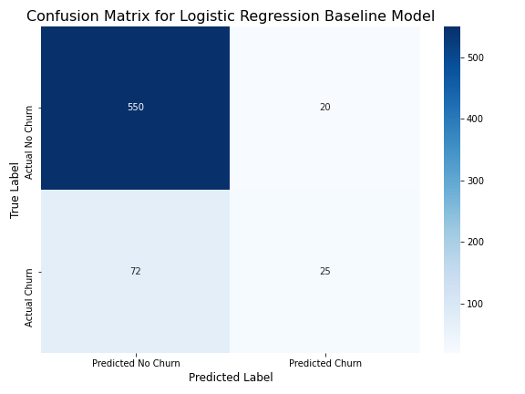
Confusion Matrix chart

Slide 15
Key Findings & Recommendations

Slide 16
What We Learned and What We Should Do
Finding #1: Customer Service Calls - Our model found that the number of customer service calls is a huge indicator of churn. Customers with more than two calls are far more likely to leave.
Finding #2: International Plan - Customers with an international plan churn at a much higher rate than those without one.

Slide 17
What We Learned and What We Should Do(2)
Recommendation 1: Actionable Daily List
Recommendation 2: Deeper Dive into Service Calls
Recommendation 3: Examine the International Plan

Slide 18
Recommendation 1: Actionable Daily List
The Customer Retention Manager should use the model to generate a daily list of high-risk customers for immediate outreach.
.

Slide 19
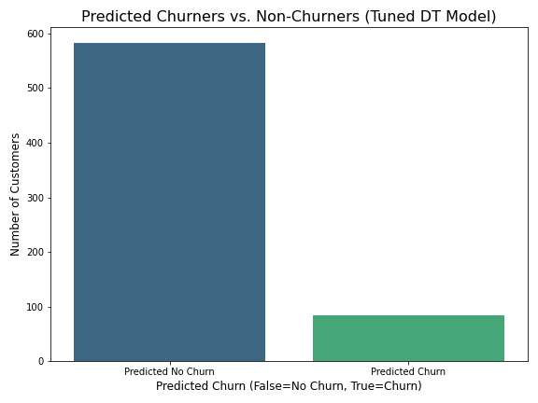
Recommendation 1: Actionable Daily List
.

Slide 20
Recommendation 2: Deeper Dive into Service Calls
We need to investigate the specific reasons behind the high number of customer service calls to address the root cause of the churn.

Slide 21
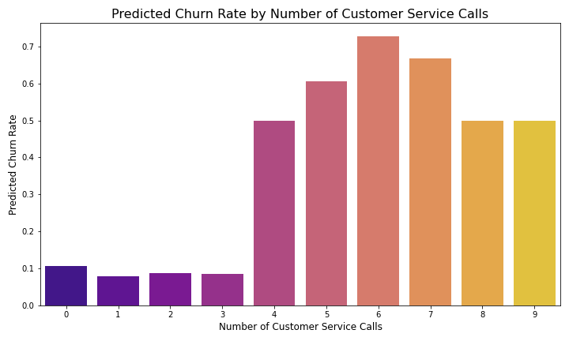
Recommendation 2: Deeper Dive into Service Calls

Slide 22
Recommendation 3: Examine the International Plan
We should conduct a deep analysis of the international plan, including its features and pricing, to understand why it's a major churn driver.

Slide 23
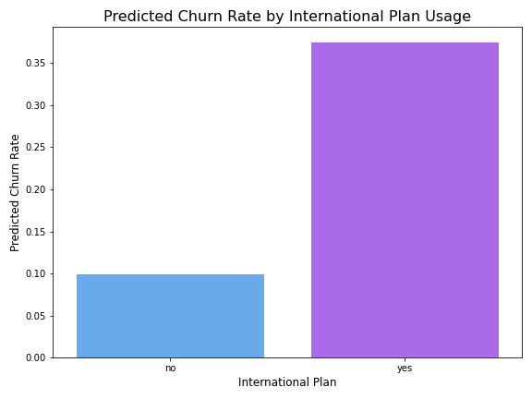
Recommendation 3: Examine the International Plan

Slide 24
Next Steps

Slide 25
Putting Insights into Action
Implement a Pilot Program: Start by testing the daily high-risk customer list with a small team to measure the impact on churn.
Qualitative Analysis: Conduct interviews with customers who have made multiple service calls to understand their frustrations and pain points.
Product Review: Work with the Product and Marketing teams to review and potentially revise the international plan offering.

Slide 26
Thank You

Slide 27
Questions & Discussion

